Slide 1
Group 13
Fake News Detection
Multilingual Fake News Detection Using RoBERTa and Other Machine Learning Models

Slide 2
Fake News Detection Across Multiple Languages Using XLM-RoBERTa
The spread of fake news across languages is a major challenge. Manual detection methods are inefficient, especially when dealing with large-scale, multilingual news data. This project develops an automated fake news detection system using the
XLM-RoBERTa transformer, which can classify news articles as "True" or "Fake" across six Indian languages (English, Hindi, Bangla, Gujarati, Marathi, and Telugu).
Project Overview

Slide 3
Motivation and Challenges
Misinformation Threat
Complex Language and Data Challenges
Model Interpretability
The rise of fake news erodes public trust and spreads misinformation, making it essential to develop automated detection systems.
Machine learning models offer an effective solution by using advanced natural language algorithms, and understanding to differentiate between real and fake news.
Fake news often imitates real news in style and tone, making it hard to detect.
Additionally, the diversity of news sources, topics, and languages complicates feature extraction and classification, while data imbalance between real and fake news can affect model performance.
While models like RoBERTa excel in accuracy, their deep architecture can make it difficult to interpret the reasons behind specific predictions, posing challenges in understanding and justifying the classification of fake news.

Slide 4
Jagvinder & Anurudh Singh -
Data exploration and Observation
Aman & Rishab Yadav - Preprocessing
Prathmesh & Harshit Yadav-
Model Development
Mahender Dhaka & Pradeep Meena-Inference and Results
Work
Distribution

Slide 5
Novelty
1. Multilingual Dataset Compilation
Many fake news detection models focus on a single language (mostly English). Our project is unique as it integrates both Hindi and other languages, making it more practical for multilingual environments like India.
Combining regional language datasets (Bangla, Gujarati, Marathi, Telugu) with broader datasets demonstrates the novel creation of a unique multilingual benchmark for fake news detection.
2.Enhanced XLM-RoBERTa Architecture with Dynamic Optimization
Extending the XLM-RoBERTa model with additional fully connected layers and employing dynamic learning rate adjustments (using ReduceLROnPlateau) ensures improved performance and efficient convergence on diverse multilingual datasets, creating a robust solution for cross-linguistic fake news detection.

Slide 6
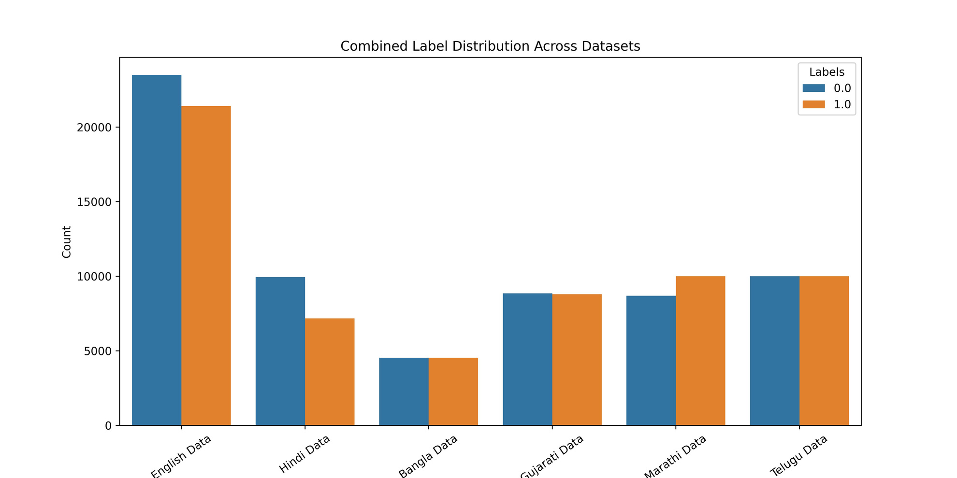
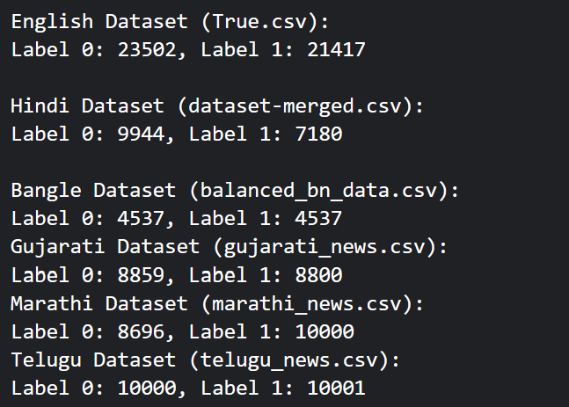
Overview of Dataset (Multilingual) :
Source: This dataset is publicly available on Kaggle and was collected from various news sources to facilitate research in fake news detection. It serves as a benchmark for machine learning projects focused on identifying misinformation across multiple languages. The above Dataset has been cleaned to form 2 column containing Text and Label.

Slide 7
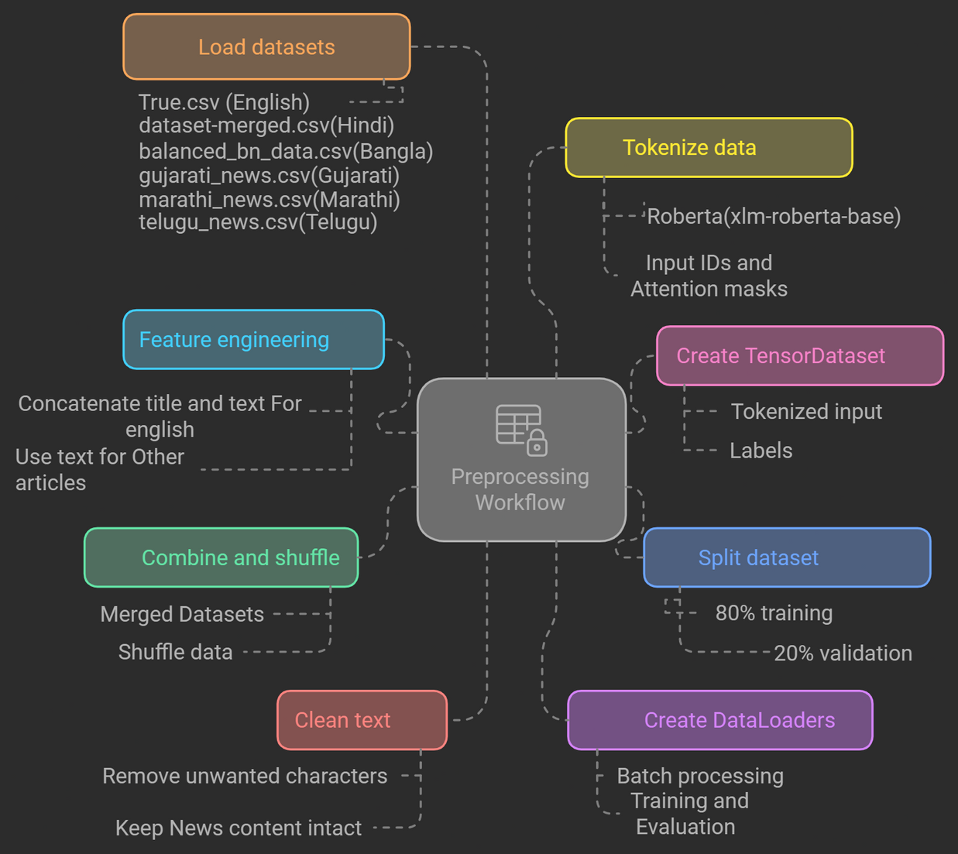
Preprocessing and Data preparation
For RoBERTa Model-

Slide 8
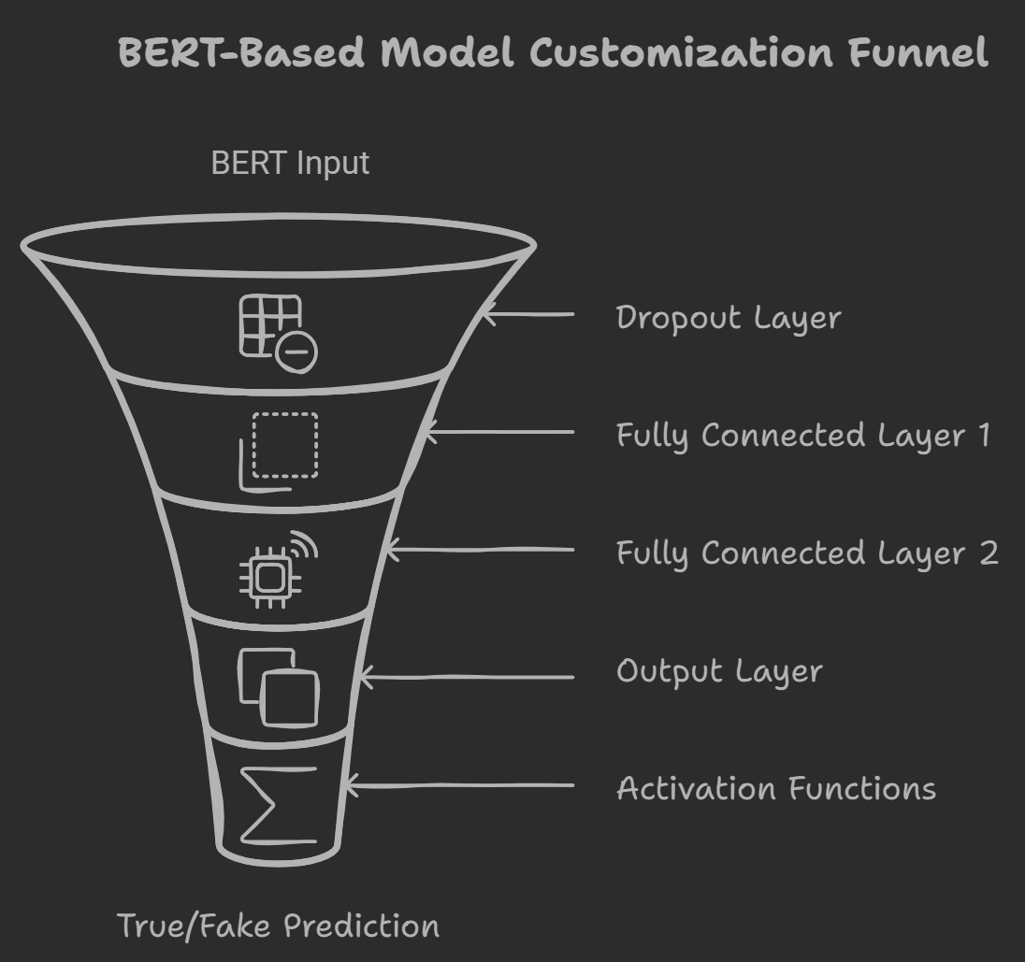
Roberta Model Architecture
XML Roberta Based Customization Funnel
Base Model: Roberta (using pre-trained weights, parameters frozen).
Custom Layers:
Dropout Layer: To prevent overfitting.
Fully Connected Layers:
FC1: 768 (BERT output) → 512
FC2: 512 → 384
Output Layer: 384 → 2 (True, Fake)
Activation Functions:
ReLU for non-linearity.
Softmax for final probabilities.
Roberta input

Slide 9
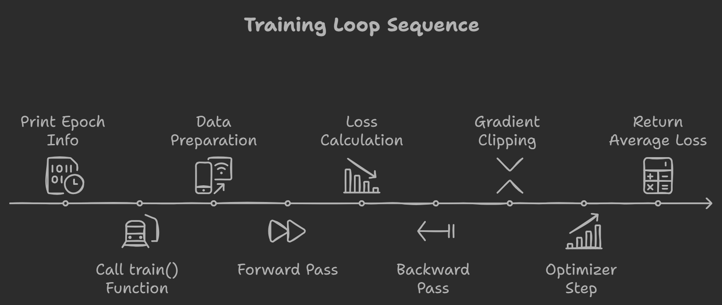
Model Training and Evaluation -
Optimiser Used - AdamW, Learning Rate=1e-5
Schedular -ReduceLROnPlateau (optimizer, mode='min', factor=0.5, patience=2, verbose=True)
Batch Size - 8
Training and Validation split is 80:20

Slide 10
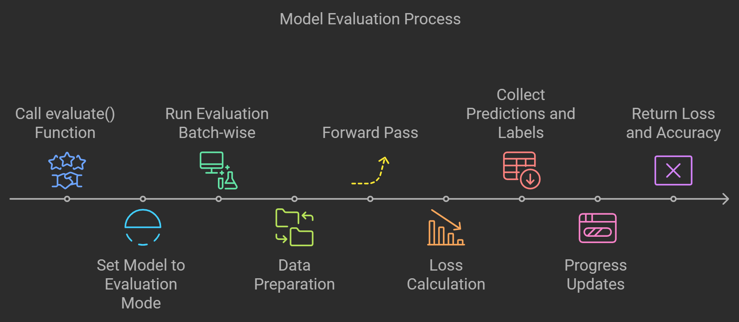
Model Training and Evaluation -
Since the model uses LogSoftmax in the final layer, the NLLLoss function is appropriate for calculating the loss based on the log-probabilities of the classes.
Total Epoch is 5
At last, Best model Weight is saved

Slide 11
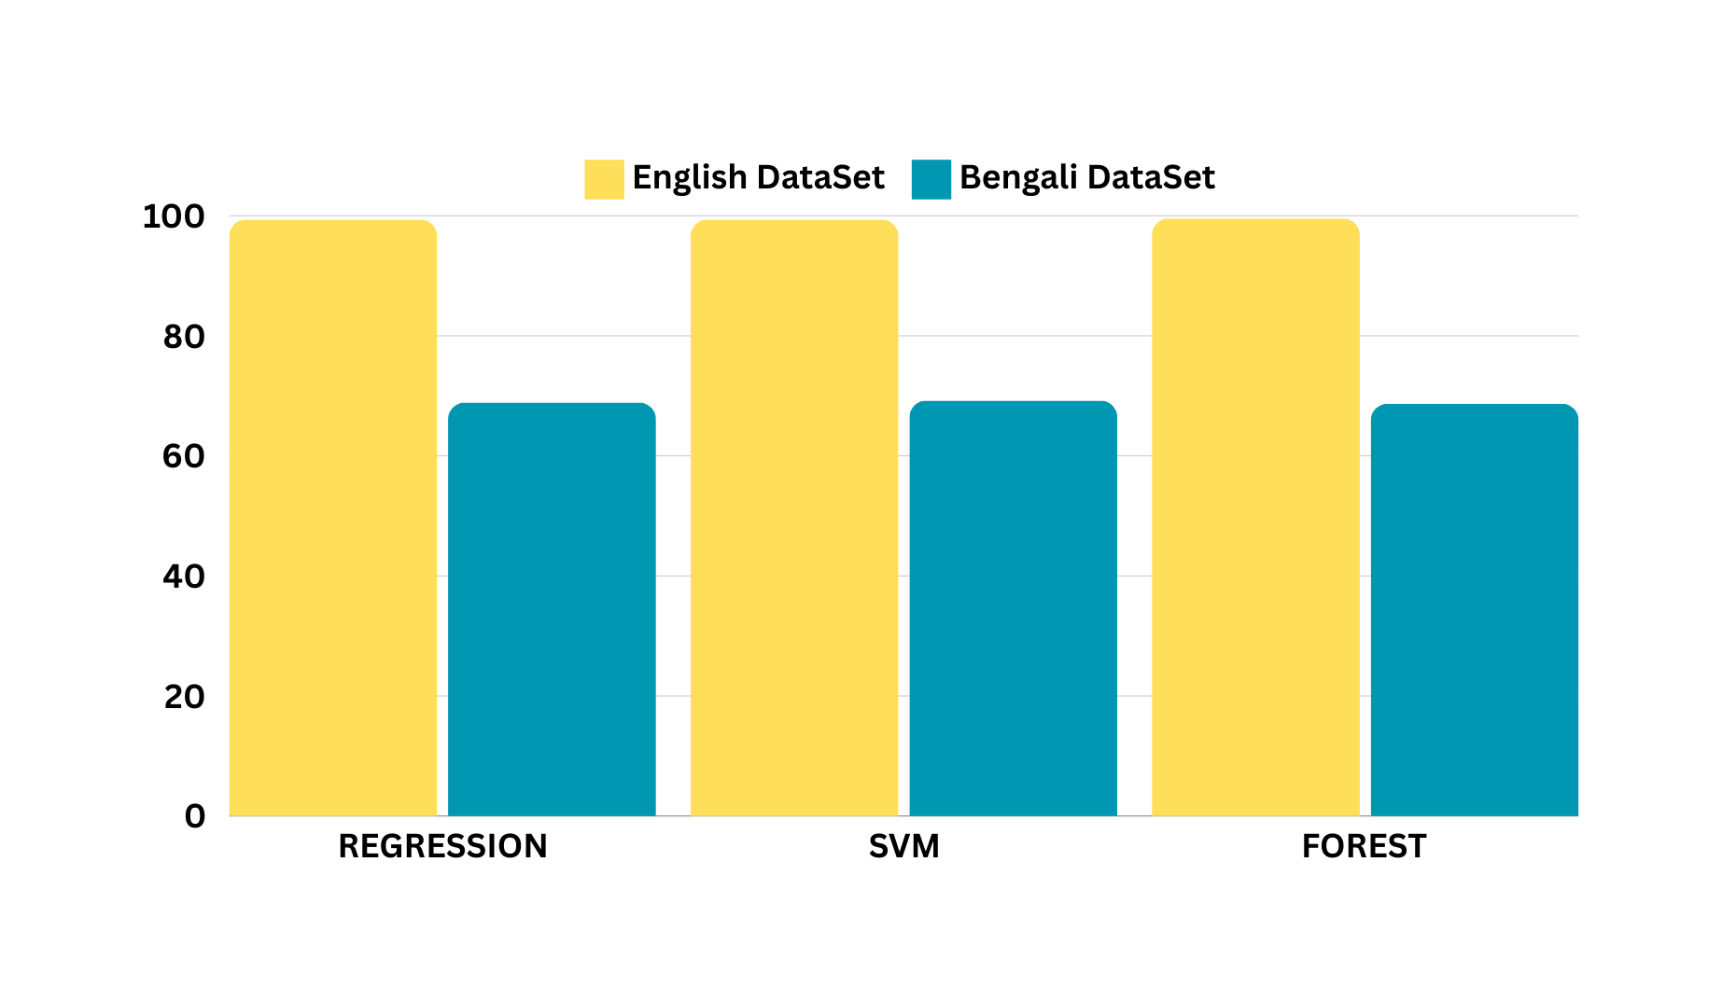
Classifier Model Comparison
Accuracy

Slide 12
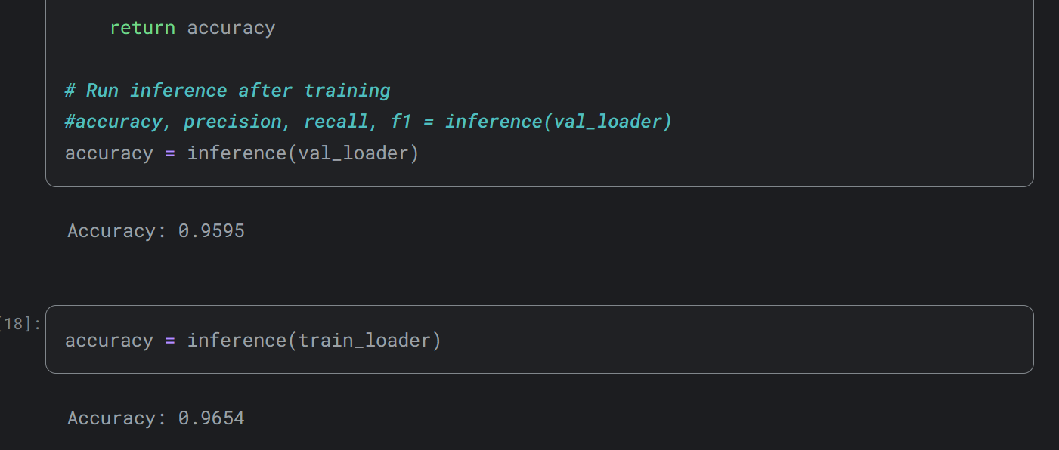
Results & Inference
Accuracy of XLM - RoBERTa for epoch= ‘5‘
Training Time - 16 hrs

Slide 13
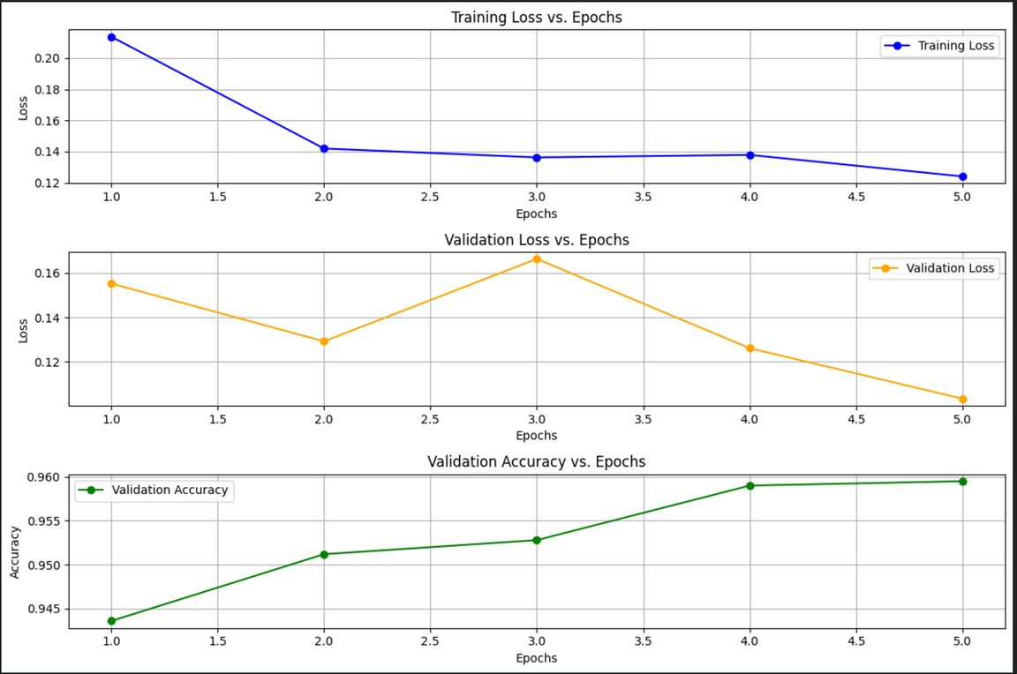
Results & Inference
The multilingual fake news detection model trained using XLM-RoBERTa has demonstrated promising performance in identifying true and fake news across different languages. With a final validation accuracy of 95.95%, the model showcases its ability to generalize well on unseen data, making it a robust solution for real-world applications.
The XLM-RoBERTa-based multilingual fake news detection model demonstrated high performance with a validation accuracy of 95.95%, showing effective learning and generalization across different languages.
With consistent improvements in training and validation loss, the model is well-suited for real-world applications in detecting fake news, and further enhancements can increase its robustness and scalability.

Slide 14
Thank
You!

